Slide 1



…your experienced partner in process control
H-3600 Ozd, Bolyki Tamas street 44.
Tel.: +36-48/572-310; +36-48/472-269
Fax: +36-48/572-313; +36-48/471-642
E-mail: info@phoenix-brv.hu
homepage: www.phoenix-brv.hu

Slide 2

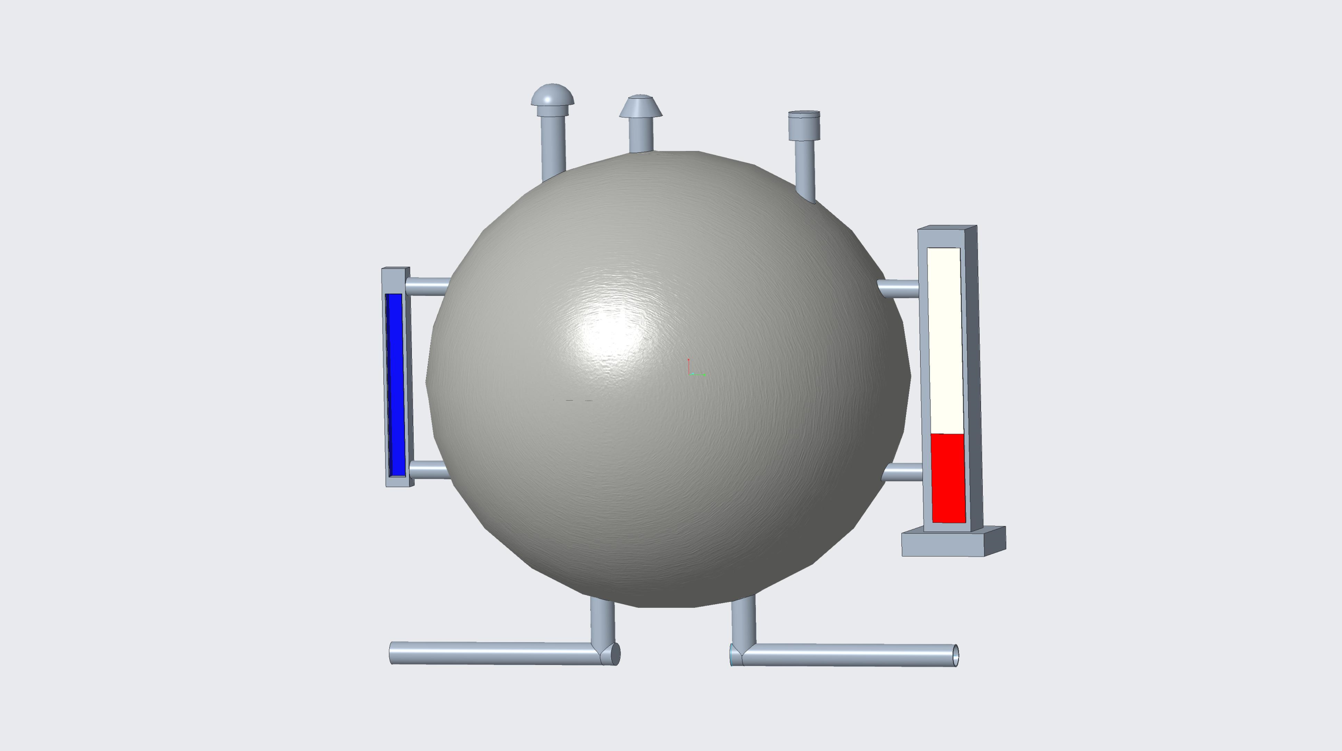
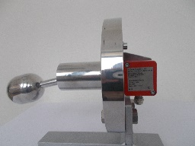
PRODUCT OVERVIEW
FLAME & EXPLOSION ARRESTERS
LEVEL TRANSMITTERS
IN & OUT BREATHERS
MAGNETIC LEVEL GAUGES
SIGHT GLASS LEVEL GAUGES
LEVEL SWITCHES
ROTAMETERS & VENTURI TUBES
ROTAMETERS & VENTURI TUBES
IN
OUT

Slide 3
PRODUCT OVERVIEW
FLAME & EXPLOSION ARRESTERS
LEVEL TRANSMITTERS
IN & OUT BREATHERS
MAGNETIC LEVEL GAUGES
SIGHT GLASS LEVEL GAUGES
LEVEL SWITCHES
ROTAMETERS & VENTURI TUBES
ROTAMETERS & VENTURI TUBES
IN
OUT

Slide 4
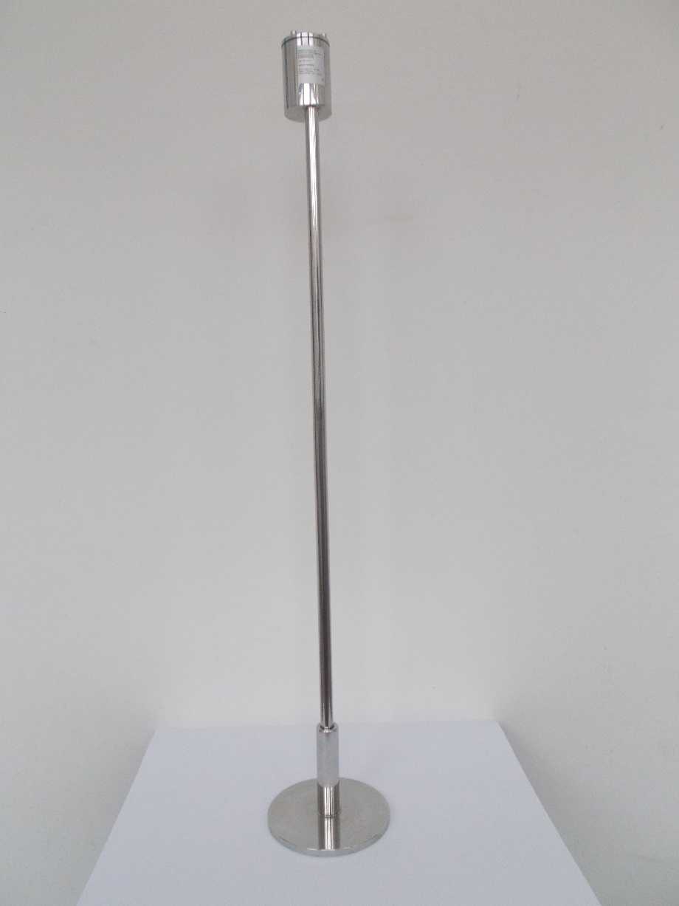
LEVEL TRANSMITTER
TUBULAR LEVEL GAUGES
Type: 745 1XXX
or 746 1XXX
Remote control
Connect: EN or ANSI
Flange or thread
Measuring Lenght:
200-10000 mm
Resolution: 5 or 10 mm
Diameter of sensor pipe: 14 mm
Body: SST , Titan , PTFE
coating
Output signal: 4- 20 mA
2 or 3 wire output
Supply voltage: 8-36 V DC
HART Protocol
Zona 0
Ex & ATEX Cert
TUBULAR LEVEL GAUGES
MAGNETIC LEVEL GAUGES
MAGNETIC LEVEL GAUGES
LEVEL SWITCHES
LEVEL SWITCHES
ROTAMETERS & VENTURI TUBES
ROTAMETERS & VENTURI TUBES
IN
OUT

Slide 5
PRODUCT OVERVIEW
FLAME & EXPLOSION ARRESTERS
LEVEL TRANSMITTERS
IN & OUT BREATHERS
MAGNETIC LEVEL GAUGES
SIGHT GLASS LEVEL GAUGES
LEVEL SWITCHES
ROTAMETERS & VENTURI TUBES
ROTAMETERS & VENTURI TUBES
IN
OUT

Slide 6
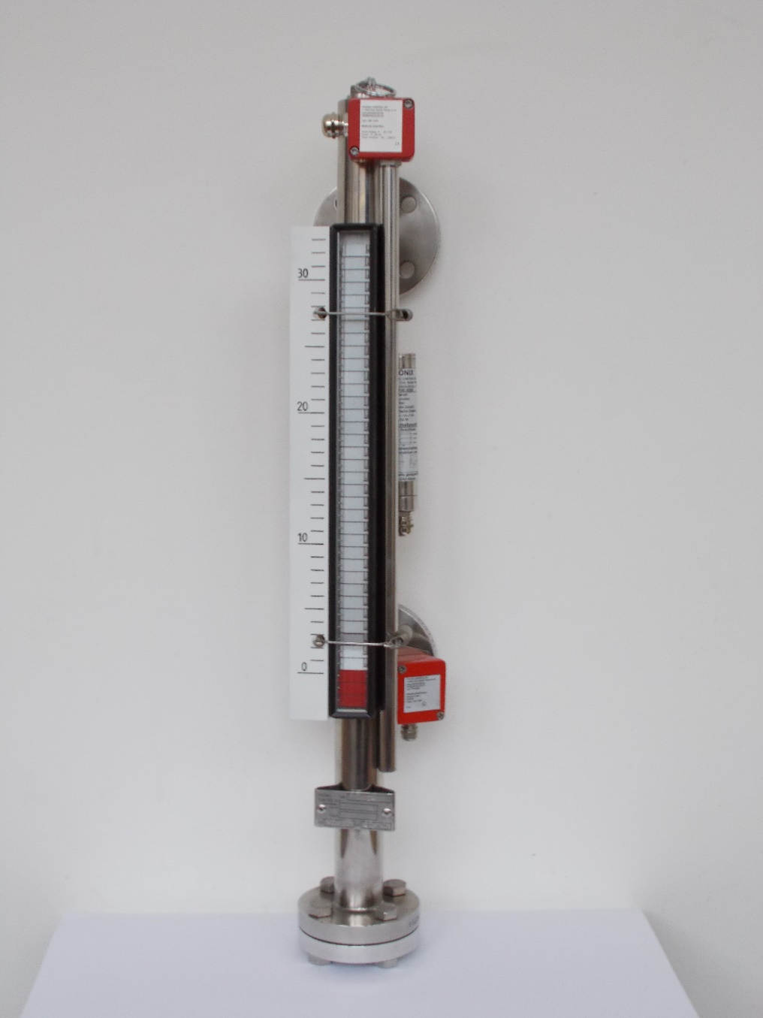
MAGNETIC LEVEL GAUGES
Type 710XXX
Range of Application:
- up to PN 400
- -196 to +450 C°
- densities down to 0,35 g/cm3
Materials body DIN/ANSI:
- flanges stainless stell or steel
- nickel alloys, titanium
- plastics
- linings, contains: ECTFE,
PTFE, rubber...
Materials float:
- stainless steel
- titanium, nickel alloys,...
- plastics
- glass
Special accessories
- calibrated floats designed for
densities +0,01 g/cm3 and
interface measurement
- indicating scales for low or high
temperatures and/or
corrosive atmospheres
NUCLEAR REFERENCE SINCE 1992
TUBULAR LEVEL GAUGES
TUBULAR LEVEL GAUGES
MAGNETIC LEVEL GAUGES
MAGNETIC LEVEL GAUGES
LEVEL SWITCHES
LEVEL SWITCHES
ROTAMETERS & VENTURI TUBES
ROTAMETERS & VENTURI TUBES
IN
OUT

Slide 7
PRODUCT OVERVIEW
FLAME & EXPLOSION ARRESTERS
LEVEL TRANSMITTERS
IN & OUT BREATHERS
MAGNETIC LEVEL GAUGES
SIGHT GLASS LEVEL GAUGES
LEVEL SWITCHES
ROTAMETERS & VENTURI TUBES
ROTAMETERS & VENTURI TUBES
IN
OUT

Slide 8
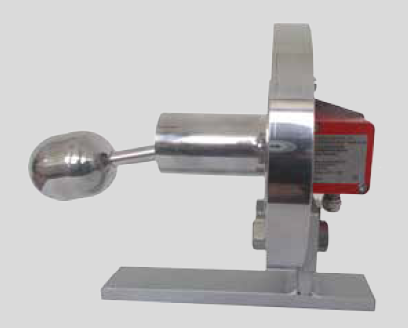

LEVEL SWITCH
TUBULAR LEVEL GAUGES
TUBULAR LEVEL GAUGES
different switch modules:
reed switch
semiconducor relay
• mechanical contacts
• proximity switches
• fail safe design
• switch modules totally
separated by flange
• T: -65...+350 °C
• P: 25 MPa (250 bar)
• Ex
MAGNETIC LEVEL GAUGES
MAGNETIC LEVEL GAUGES
LEVEL SWITCHES
LEVEL SWITCHES
ROTAMETERS & VENTURI TUBES
ROTAMETERS & VENTURI TUBES
IN
OUT

Slide 9
PRODUCT OVERVIEW
FLAME & EXPLOSION ARRESTERS
LEVEL TRANSMITTERS
IN & OUT BREATHERS
MAGNETIC LEVEL GAUGES
SIGHT GLASS LEVEL GAUGES
LEVEL SWITCHES
ROTAMETERS & VENTURI TUBES
ROTAMETERS & VENTURI TUBES
IN
OUT

Slide 10
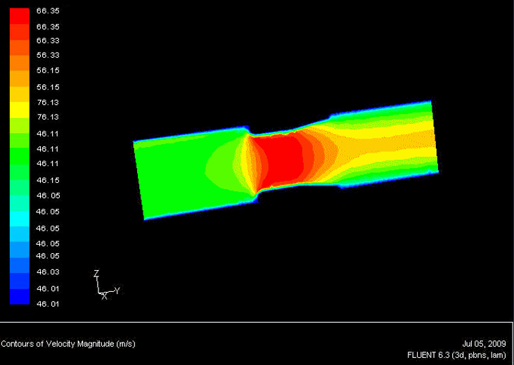
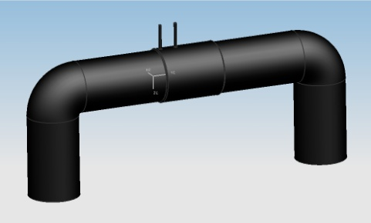
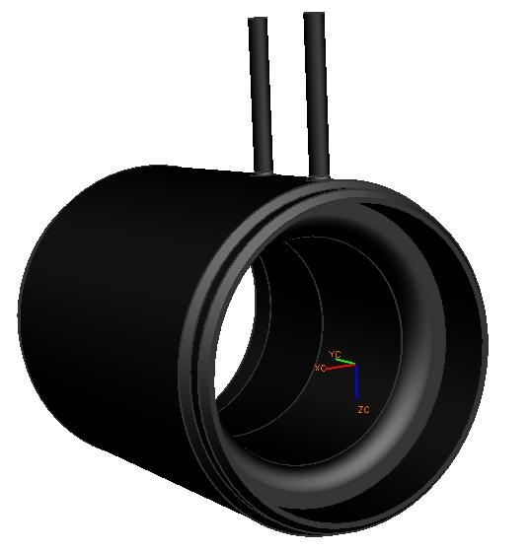
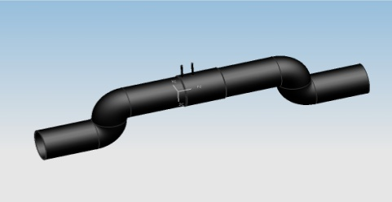
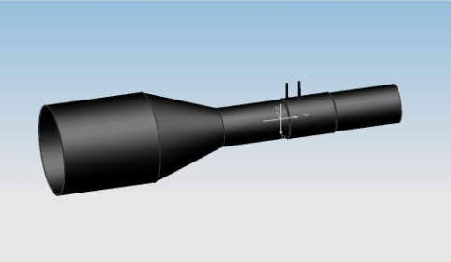
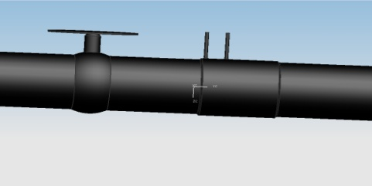
VENTURI TUBES
TUBULAR LEVEL GAUGES
STRUCTURE | ORIFICE PLATE BEFORE/AFTER | VENTURI BEFORE/AFTER | SHORT VENTURI BEFORE/AFTER
 | 16D/6D | 17D/7D | 3D/3D
 | 22D/7D | 23D/9D | 5D/3D
 | 8D/3D | 8D/5D | 5D/3D
 | 24D/7D | 24D/8D | 7D/3D
TUBULAR LEVEL GAUGES
MAGNETIC LEVEL GAUGES
MAGNETIC LEVEL GAUGES
LEVEL SWITCHES
LEVEL SWITCHES
ROTAMETERS & VENTURI TUBES
ROTAMETERS & VENTURI TUBES
NUCLEAR REFERENCE SINCE 2000
IN
OUT

Slide 11
PRODUCT OVERVIEW
FLAME & EXPLOSION ARRESTERS
LEVEL TRANSMITTERS
IN & OUT BREATHERS
MAGNETIC LEVEL GAUGES
SIGHT GLASS LEVEL GAUGES
LEVEL SWITCHES
ROTAMETERS & VENTURI TUBES
ROTAMETERS & VENTURI TUBES
IN
OUT

Slide 12
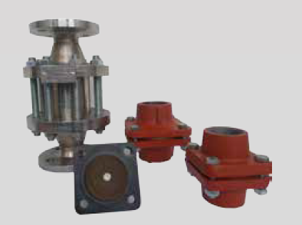
FLAME & EXPLOSION ARRESTERS
TUBULAR LEVEL GAUGES
TUBULAR LEVEL GAUGES
Nominal diameter: DN15 - DN500 1/2" - 20" products and services.
• Design: in-line deflagration arrester
in-line detonation arrester
• Certificate: EC prototype test cartificate
according guide line 94/9/EC
• Application: gas/air-or vapour/air-mixtures
of the explosion groups
• I (methane) - IIA(D)
MAGNETIC LEVEL GAUGES
MAGNETIC LEVEL GAUGES
LEVEL SWITCHES
LEVEL SWITCHES
ROTAMETERS & VENTURI TUBES
ROTAMETERS & VENTURI TUBES
IN
OUT

Slide 13
PRODUCT OVERVIEW
FLAME & EXPLOSION ARRESTERS
LEVEL TRANSMITTERS
IN & OUT BREATHERS
MAGNETIC LEVEL GAUGES
SIGHT GLASS LEVEL GAUGES
LEVEL SWITCHES
ROTAMETERS & VENTURI TUBES
ROTAMETERS & VENTURI TUBES
IN
OUT

Slide 14
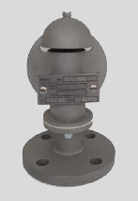
IN OUT BREATHERS
TUBULAR LEVEL GAUGES
TUBULAR LEVEL GAUGES
Product Group KBLII
Type BRV 946
Application Areas
Oil, chemical, gas and energy plants, containers
highly inflammable and explosive facilities in
the system, ensure the pressure and vacuum to be compensated.
General Info
With flanged connections built for tanks, mounted
plate on a device, with a quality certificate.
Engineering data
Connection Sizes: DN15-DN200
Pressure Grades: - 500 mBar + 20 Bar
Operating Temperature: - 40°C...+80°C
Material Quality
- Carbon steel(1.0570)
- Stainless Steel (1.4301;1.4404;1.4571)
- Other (Aluminium Alloys)
MAGNETIC LEVEL GAUGES
MAGNETIC LEVEL GAUGES
LEVEL SWITCHES
LEVEL SWITCHES
ROTAMETERS & VENTURI TUBES
ROTAMETERS & VENTURI TUBES
IN
OUT

Slide 15
PRODUCT OVERVIEW
FLAME & EXPLOSION ARRESTERS
LEVEL TRANSMITTERS
IN & OUT BREATHERS
MAGNETIC LEVEL GAUGES
SIGHT GLASS LEVEL GAUGES
LEVEL SWITCHES
ROTAMETERS & VENTURI TUBES
ROTAMETERS & VENTURI TUBES
IN
OUT

Slide 16
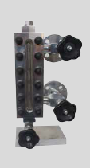
SIGHT GLASS LEVEL GAUGES
TUBULAR LEVEL GAUGES
TUBULAR LEVEL GAUGES
For application in:
- chemical, petrochemical
industries
- power plants, steam boilers
- heat transfer oils
- refrigerants
- low temperature
-refineries
Types:
- weld-in sight glass
- reflex level gauges
- transparent level gauges
Type 700XXX
Range of Application:
- up to PN 250
- -200 to+400 C°
Materials DIN and ANSI
- forged and rolled steel
- high temperature C-steel
- stainless steels
- monel, hastelloy...
- inner coating rubber, lead,...
- mica, frost an corrocsion
protection
- illumination, ex-proof,watertight
MAGNETIC LEVEL GAUGES
MAGNETIC LEVEL GAUGES
LEVEL SWITCHES
LEVEL SWITCHES
ROTAMETERS & VENTURI TUBES
ROTAMETERS & VENTURI TUBES
IN
OUT

Slide 17
PRODUCT OVERVIEW
FLAME & EXPLOSION ARRESTERS
LEVEL TRANSMITTERS
IN & OUT BREATHERS
MAGNETIC LEVEL GAUGES
SIGHT GLASS LEVEL GAUGES
LEVEL SWITCHES
ROTAMETERS & VENTURI TUBES
ROTAMETERS & VENTURI TUBES
IN
OUT

Slide 18
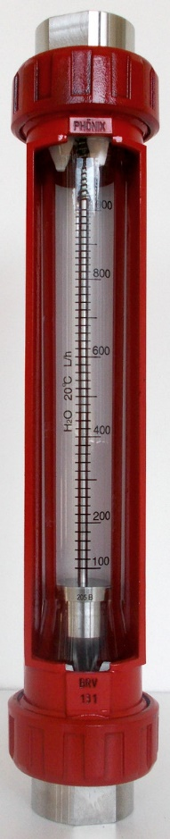
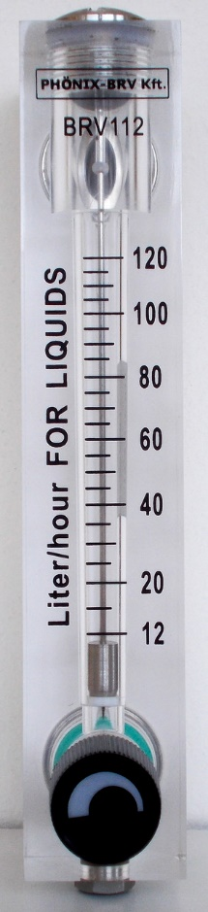
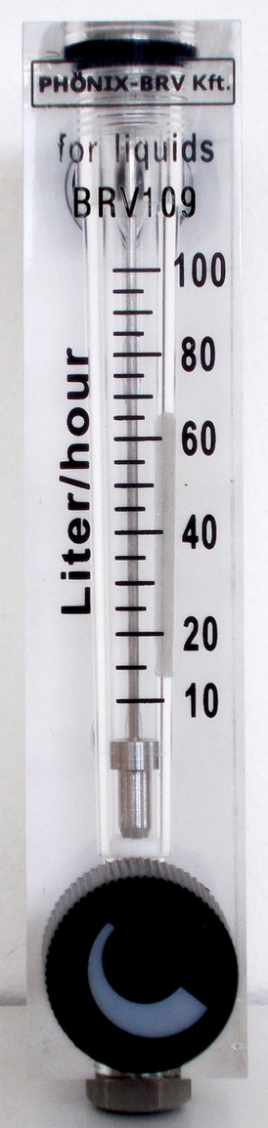
ROTAMETERS & VENTURI TUBES
NUCLEAR REFERENCE SINCE 2000
TUBULAR LEVEL GAUGES
TUBULAR LEVEL GAUGES
MAGNETIC LEVEL GAUGES
MAGNETIC LEVEL GAUGES
LEVEL SWITCHES
LEVEL SWITCHES
ROTAMETERS & VENTURI TUBES
ROTAMETERS & VENTURI TUBES
IN
OUT

Slide 19
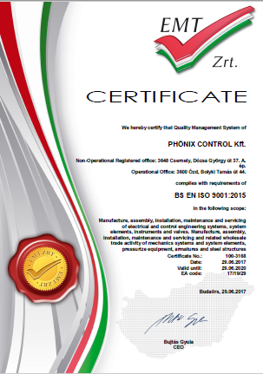
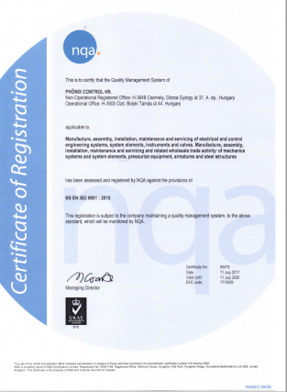
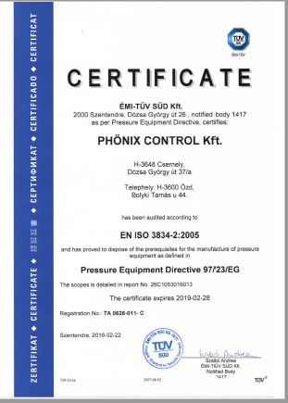
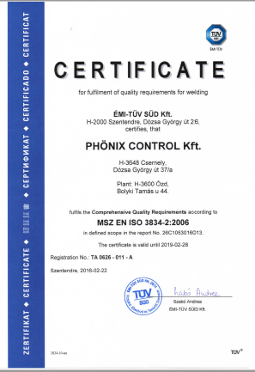
CERTIFICATES & REFERENCES
TUBULAR LEVEL GAUGES
TUBULAR LEVEL GAUGES
MAGNETIC LEVEL GAUGES
MAGNETIC LEVEL GAUGES
LEVEL SWITCHES
LEVEL SWITCHES
REFERENCES FROM NUCLEAR/PHARMACEUTICAL/ENERGY/ENGINEERING INDUSTRIES
ROTAMETERS & VENTURI TUBES
ROTAMETERS & VENTURI TUBES
IN
OUT

Slide 20
REFERENCES
TUBULAR LEVEL GAUGES
TUBULAR LEVEL GAUGES
HUNGARY
MOL , PAKS Nuclear PP, OVIT , Sanofy-CHINOIN , Wanhua, TVK, TEVA , Gázgép, Oiltech, TTG ,
EUROPE
Camsan Turkey, Atlantics Global Line Turkey, CIC Energy Italy, GS Automation Italy, Burkhardt Compression Italy, REXIMA Germany, Cominteg Germany, V-Line Germany, Thomas Kurze Germany, EMPETRA Poland, Delta P France, Emerson France, Habau PPS Romania, LINDE Romania, SC Driatheli Romania, SHELL Nederland, VAPOR Y Srl Spain, Kavala Oil Greece, Topas Czech Rep. , JSP Czech Rep. , Emerson Russia , IAF GmbH Austria , TIME-LINE Ltd England
ASIA
Petro Arses Co. Iran , Behbood Farayand Co Iran , Petro Tamin Iran , Tavan Sazan Co Iran , Oil &Gas Iran , Fanavaran Petrochemical Iran ,NARGA Iran , Petrochemical Ind. Co Kuwait , WEEECO Ind . Irak, CV Persada Indonesia , Industrial Trade Well Malaysia , Petronas Malaysia
AFRICA
BEAM International Libanon , SOKH EFC Egyp , 3G Engineering Dubai , Petro Gas Abudhabi, Kalhour Oil Dubai ,Anwar Alganat Dubai , Prime Star Int. Dubai , Lido General Trading Dubai ,
Seven Star Oil Dubai , Emerson Dubai, Al Hamid Trading Dubai, SEWKAN Ltd Dubai, ANWAR ALGANAT Dubai , Maersk Oil Qatar, Qatar Fertiliser Company Qatar, Qatar Petroleum , SUMAR Indistries Qatar , GULF Trading Oman, Insight Sudan, KOSPHE Mauritius
AUSTRALIA - USA
HMA Inst. Australia , CEBECO Ltd Australia , Bunbury Australia , Bluewater Australia, UNIFLOW Power Australia , Global Trading USA
MAGNETIC LEVEL GAUGES
MAGNETIC LEVEL GAUGES
LEVEL SWITCHES
LEVEL SWITCHES
ROTAMETERS & VENTURI TUBES
ROTAMETERS & VENTURI TUBES
IN
OUT

Slide 21
…your experienced partner in process control
THANK YOU FOR YOUR KIND ATTENTION
H-3600 Ozd, Bolyki Tamas street 44.
Tel.: +36-48/572-310; +36-48/472-269
Fax: +36-48/572-313; +36-48/471-642
E-mail: info@phoenix-brv.hu
homepage: www.phoenix-brv.hu

